Slide 1




Towards Multi-Criteria Prioritization of Best Practices in Research Artifact Sharing
Scan to access the paper!
CDN (Diego) Damasceno ª, Isotilia Costa Melo ^{b}, and Daniel Strüber ^{a,c}
d.damasceno@cs.ru.nl, isotilia@gmail.com, d.struber@cs.ru.nl
Radboud University Nijmegen ª, Universidad Adolfo Ibáñez (UAI) ^{b}, and University of Gothenburg ^{c}
1st Workshop on Open Science Practices for Software Engineering (OpenScienSE 2021)

Slide 2
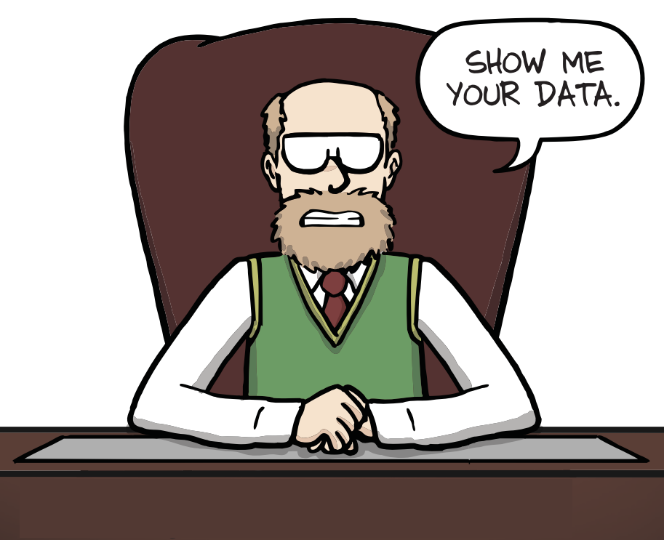
Let me ask you a question…
Are papers our only legacy as researchers?
Adapted from J. G. Cham, Prof. Smith’s rules for advising grad students (& postdocs), 1st edition. Los Angeles, CA: Piled Higher and Deeper Pub., LLC, 2018.

Slide 3




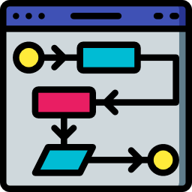




Software Artifacts: ”a[ny] digital object that was either created by the authors to be used as part of the study or generated by the experiment itself”
Association for Computing Machinery. Artifact Review and Badging Version 1.1 - Aug. 24, 2020
UML
Images from https://www.flaticon.com/

Slide 4
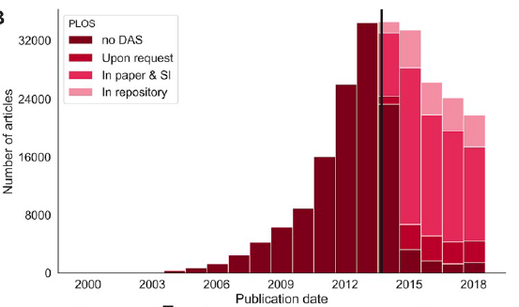
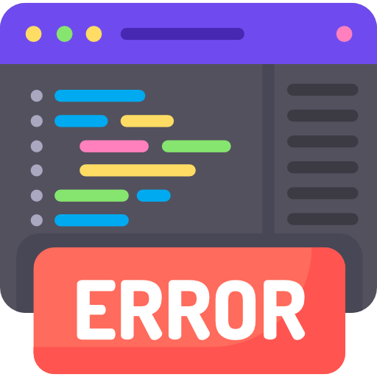




Research Artifacts
“validation of claims and result”
B. Hermann, et. al, ‘Community expectations for research artifacts and evaluation processes’, in ESEC/FSE 2020
“citation advantage”
G. Colavizza, et. al, ‘The citation advantage of linking publications to research data’, PLoS ONE, 2020
“foster replicability and reusability”
R. Heumüller, et. al, ‘Publish or perish, but do not forget your software artifacts’, Empir Software Eng, 2020

Slide 5


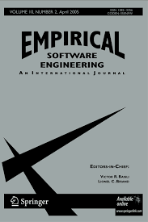







Artifact Evaluation Committee (AEC) in Software Engineering
First pilot: ESEC/FSE 2011
Authors encouraged to share their data in a replication package
If an artifact is successfully evaluated, the associated publication can receive a badge
ACM. Artifact Review and Badging Version 1.1

Slide 6
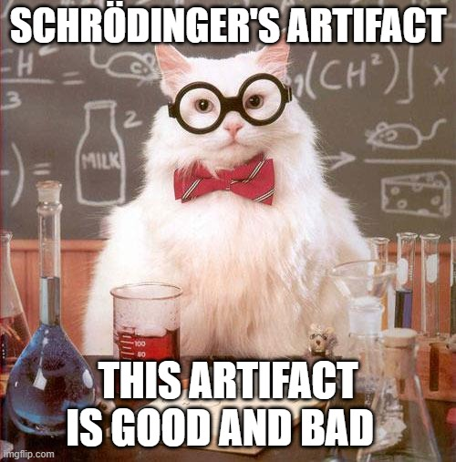
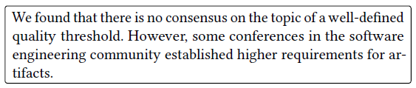
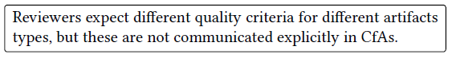
Problem Statement
B. Hermann, et. al, ‘Community expectations for research artifacts and evaluation processes’, in ESEC/FSE 2020

Slide 7
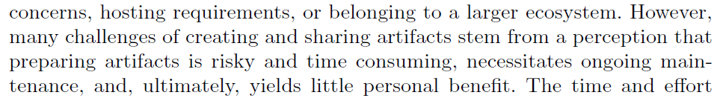
Problem Statement
C. S. Timperley, et. al, ‘Understanding and improving artifact sharing in software engineering research’, Empir Software Eng, 2021

Slide 8
Research Objective
We present our initial thoughts on a generic framework for software engineering (SE) research artifact quality management.

Slide 9
The Framework

Slide 10
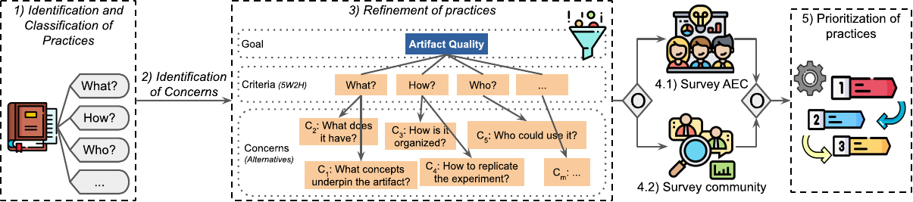
The Framework

Slide 11
Identification of Research Practices and Artifact Quality Concerns

Slide 12
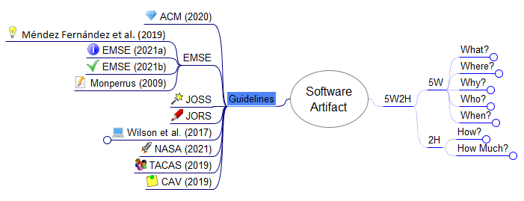

Identification of Research Practices and Artifact Quality Concerns
Five Ws and two Hs (5W2H) as content tags
Present best practices as answers to factual questions
Gain insights on types of questions could be addressed
Mind maps for data representation
Kick off the creation of domain-specific guidelines

Slide 13
Refinement of Practices

Slide 14
Refinement of Practices
Combine redundant recommendations
Identify quality concerns
Literature review
Surveys, Interviews
Hierarchy of factual questions
Categories of concerns

Slide 15
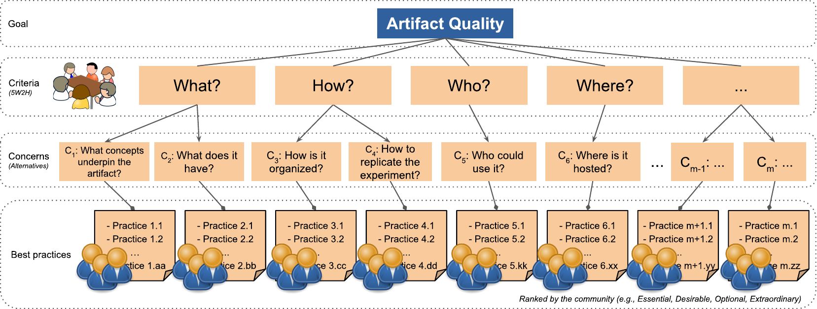
Hierarchy of Factual Questions
What research practices and artifact quality concerns are of utmost importance for research software sustainability?

Slide 16
Survey AEC members and the Community

Slide 17
Survey AEC members and the Community
Ranking factual questions and best practices
Prioritization (e.g., essential, desirable)
Time and resource constraints
Different stakeholders
AEC members (e.g., reviewers, chairs)
Overall community (e.g., academics, industry, students)

Slide 18
Prioritization of Practices

Slide 19
Prioritization of Practices
Community engagement
Different judgments
Multi-Criteria Prioritization
Analytic Hierarchy Process (AHP)
Relative importance of:
Criteria, Concerns, and Practices

Slide 20
Preliminary Results

Slide 21
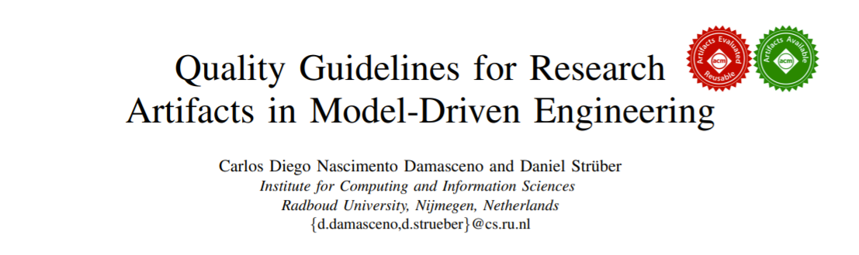
Paper accepted at the MoDELS 2021 (to appear)

Slide 22
Paper accepted at the MoDELS 2021 (to appear)

Slide 23
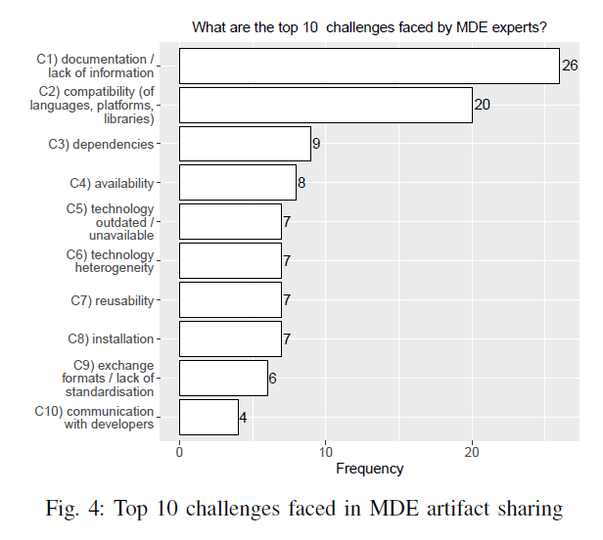
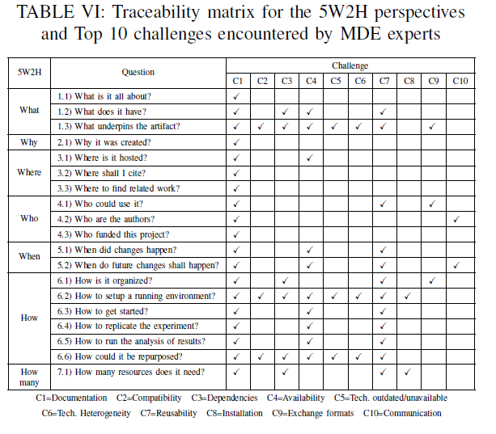
How do our guidelines addressed challenges encountered by experts?
Notes:
In the What, How and How Many perspectives, we identified various practices able to address challenges from C2 to C7.
Examples:
relying on well-maintained libraries
reporting known issues/bugs/limitations, and
Indicating of library names and their respective version identifiers.

Slide 24
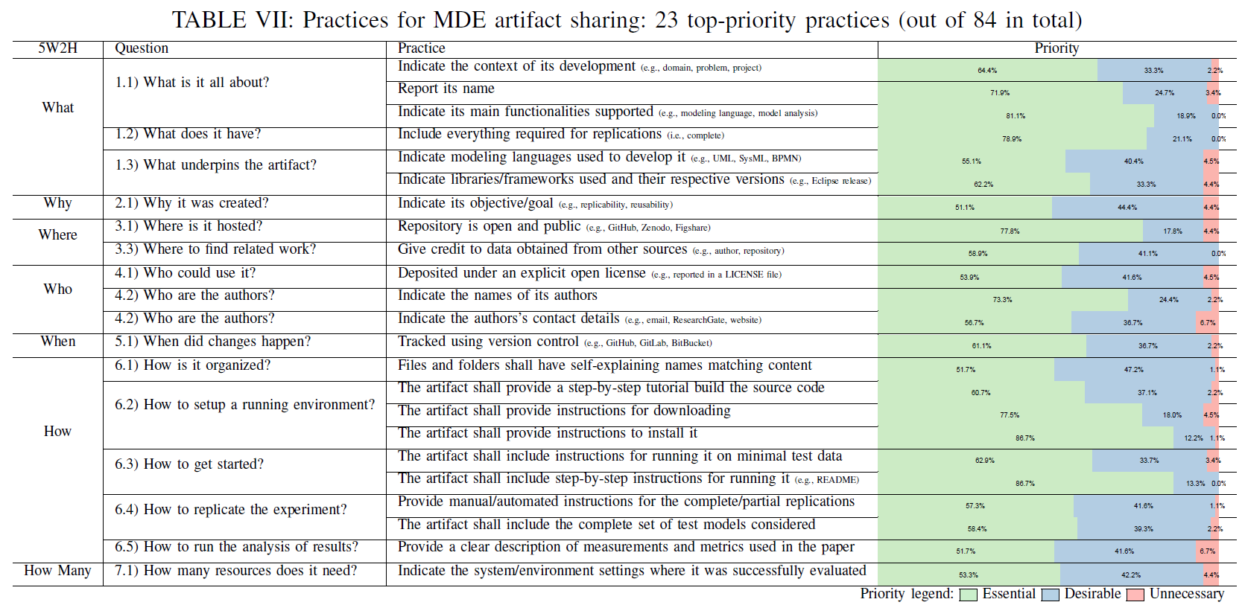
How do experts prioritized the practices in our MDE-specific guideline?
Notes:
the only question
that did not include any top priority practice was the “6.6) How
could it be repurposed?”.

Slide 25
Final Remarks

Slide 26
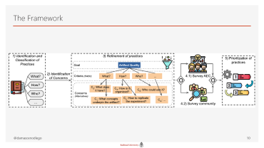
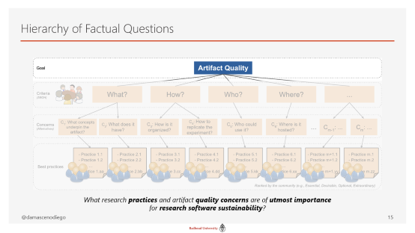
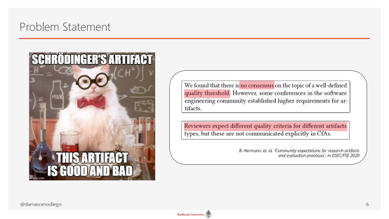
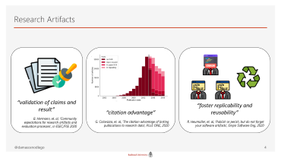


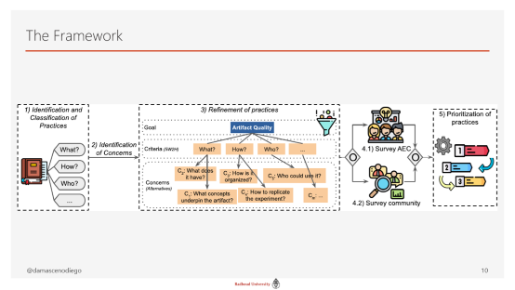

Final Remarks

Slide 27

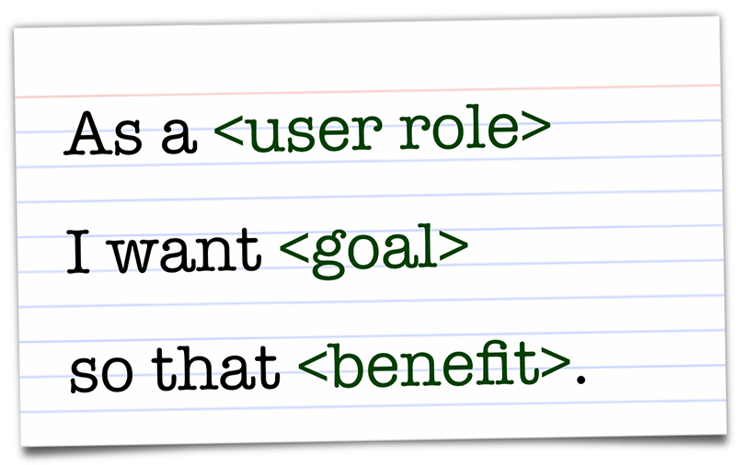
Future Work
Deeper investigation with AEC ex-/members
Retrospectives with artifact users, reviewers, creators, etc.
User stories from artifact stakeholders

Slide 28
Thank you…
…and prioritize your concerns!

Slide 29
Questions?
Scan to access the paper!
CDN (Diego) Damasceno ª, Isotilia Costa Melo ^{b}, and Daniel Strüber ^{a,c}
d.damasceno@cs.ru.nl, isotilia@gmail.com, d.struber@cs.ru.nl
Radboud University Nijmegen ª, Universidad Adolfo Ibáñez (UAI) ^{b}, and University of Gothenburg ^{c}
1st Workshop on Open Science Practices for Software Engineering (OpenScienSE 2021)

